Slide 1
A Call to Action
The Civil Rights Voting Act

Slide 2
Introduction
Mock Election
Civil Rights Movement
One Person- One Vote
Election Results
Notes:
Refer to facilitation guide.
Throughout the presentation if you have any questions, please put them in the chat. We will monitor and save time at the end of the presentation to address them.

Slide 3
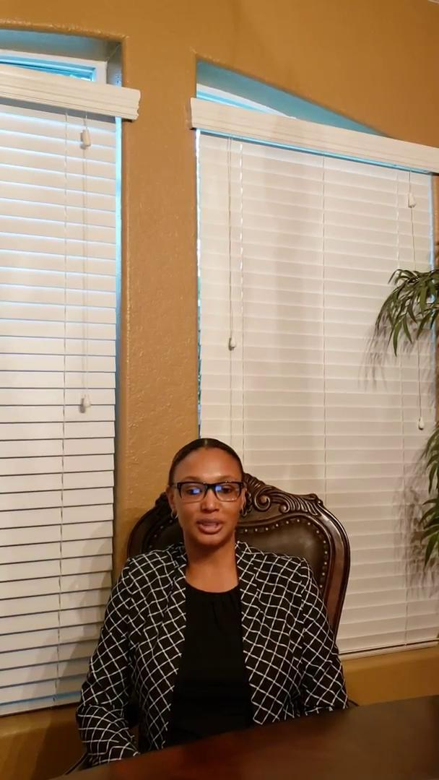
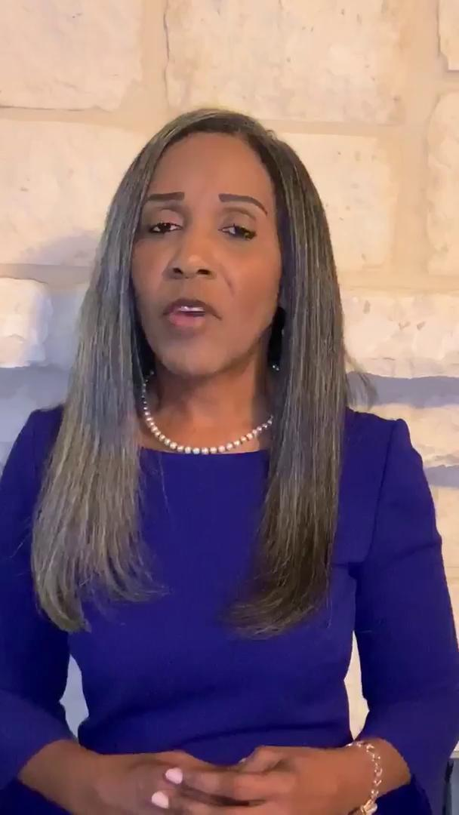
Meet the Candidates
Candidate Emerald Green
Candidate Rose White
Notes:
Click on each candidate’s picture to hear a short campaign speech.

Slide 4
Civil Rights Movement
The Civil Rights Movement was a struggle by African Americans in the mid-1950s to late 1960s to achieve Civil Rights equal to those of whites, including equal opportunity in employment, housing, and education, as well as the right to vote, the right of equal access to public facilities, and the right to be free of racial discrimination.
The national effort made by black people and their supporters in the 1950s and 1960s to eliminate segregation and gain equal rights. The first large episode in the movement, a boycott of the city buses in Montgomery, Alabama , was touched off by the refusal of one black woman, Rosa Parks, to give up her seat on a bus to a white person.
Notes:
Many religious leaders in San Antonio encouraged voluntary integration, and in many instances, such as restaurants, business owners obliged.
Sit-in demonstrations occurred at Joske’s and the Majestic Theater.
With the leadership of Harry Burns and the Reverend Claude Black, lunch counter demonstrations were set to begin on March 17, 1960 if stores did not change their segregation policies.
The NAACP also contributed to San Antonio desegregating.
San Antonio could have served as a model for other cities during the Civil Rights Movement, due to their non-violent tactics.

Slide 5
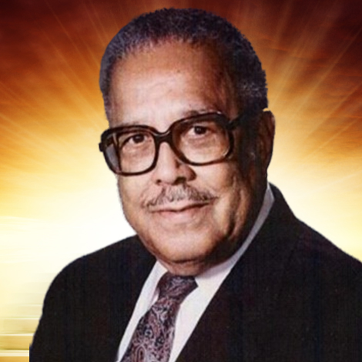
Rev Claude Black
Civil Rights Activist/Preacher
Rev. Claude W. Black passed away on March 13, 2009 after years of serving as the Pastor of Mt. Zion First Baptist Church in San Antonio, and as a civil and human rights leader. Rev. Black was a man of courage and determination in the war against racism and segregation in San Antonio. He was born on November 28, 1916 and served as the pastor of Mt. Zion First Baptist Church on the City’s East Side of San Antonio for forty-nine years and was married to ZerNona Stewart Black for fifty-nine years.
Notes:
Claude Black graduated from Morehouse University with a Bachelor’s Degree in Science.
He earned a Master’s of Divinity degree in 1943 at the Andover Newton Theological Seminary.
Rev. Black was the subject of intense FBI spying within the church and without.
Rev. Black was a delegate to the White House Conference on Civil Rights in 1966.
Rev. Black served on the San Antonio City Council from 1973-1978 and he was the city’s first black Mayor Pro Tem.
Rev. Black was appointed as a delegate to the 1995 White House Conference on Aging by President Bill Clinton.
Rev. Black was the chairperson of the Social Justice Committee of Civil Rights of the American Baptist Convention.
Rev. Black served as president of the Baptist Minister’s Union in San Antonio.
Rev. Black was a warrior and fighter for the cause of human dignity.

Slide 6
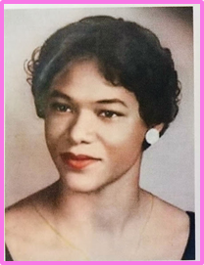
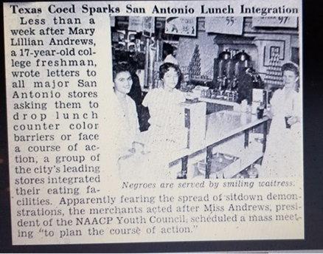
Woolworth’s Sit-In in downtown San Antonio
Mary Lillian Andrews
She wrote letters to major San Antonio stores asking them to stop lunch counter discrimination.
She used strategic tactics to avoid the violence and horror of lunch counter de-segregation activities throughout the south.
Woolworth’s peacefully and voluntarily integrated their lunches as a direct result of her efforts.
Notes:
Mary Lillian Andrews, a member of Alpha Kappa Alpha Sorority, Incorporated and 17-year old student at Our Lady of the Lake University wrote letters to major San Antonio stores asking them to stop lunch counter discrimination against blacks as a way to avoid the violence and horror of lunch counter segregation activities witnessed in other cities in the Deep South.
Several weeks later on March 16, 1960, seven downtown stores, including Woolworth’s, peacefully and voluntarily integrated their lunch counters. This event marked a first for the national sit-in movement and set a positive example for the rest of the country. The Coalition for the Woolworth Building has engaged a campaign to preserve the Woolworth Building as a national Civil Rights Site. This effort is being led by the Conservation Society of San Antonio.
The sit-in inspired dozen of similar demonstrations that were often met with police scrutiny, arrests and violence.
In San Antonio, the Woolworth Building is the site of the first successful desegregation of the lunch counter resulting from direct action, but it’s future is questionable.
an iconic structure built about 1921 on Alamo Plaza represents San Antonio’s leading role in the desegregation of lunch counters in 1960.
The preservation should stimulate a greater awareness of the importance of preserving the legacy of the modern Civil Rights era.

Slide 7
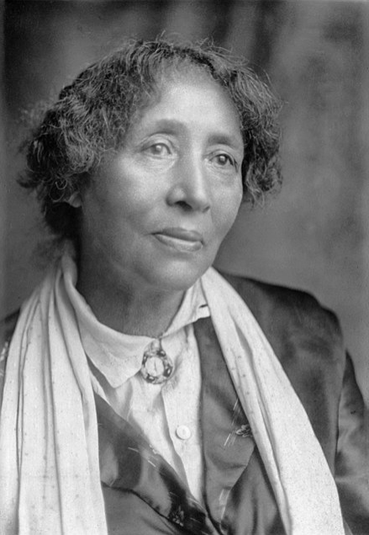
Lucy Gonzalez-Parsons
~1851 – March 7, 1942
Born into slavery around 1851, she was in Texas after the Civil War.
Met and married her husband, and they worked on racial segregation issues and voter registration of newly freed African-Americans.
In 1872, her husband was shot and threatened with lynching because of this work and their inter-racial marriage, and they left Texas for Chicago.
From that point on she is best known as a labor organizer, radical socialist and anarcho-communist
Notes:
Notes:
For many African-Americans, exact birth and death dates for ancestors born during slavery are difficult to determine.
She was believed to be of Mexican American, African American, and Native American descent and her husband was Caucasian.
In Chicago her husband was still more visible, but she became very active in the workers movement after his death, and was a supporter of anarchist and anti-racist causes. She defended Sacco and Vanzetti, two Italian anarchists falsely accused of murder who were executed, and the Scottsboro Brothers, nine Black youth framed for the rape of two white women in Alabama.

Slide 8
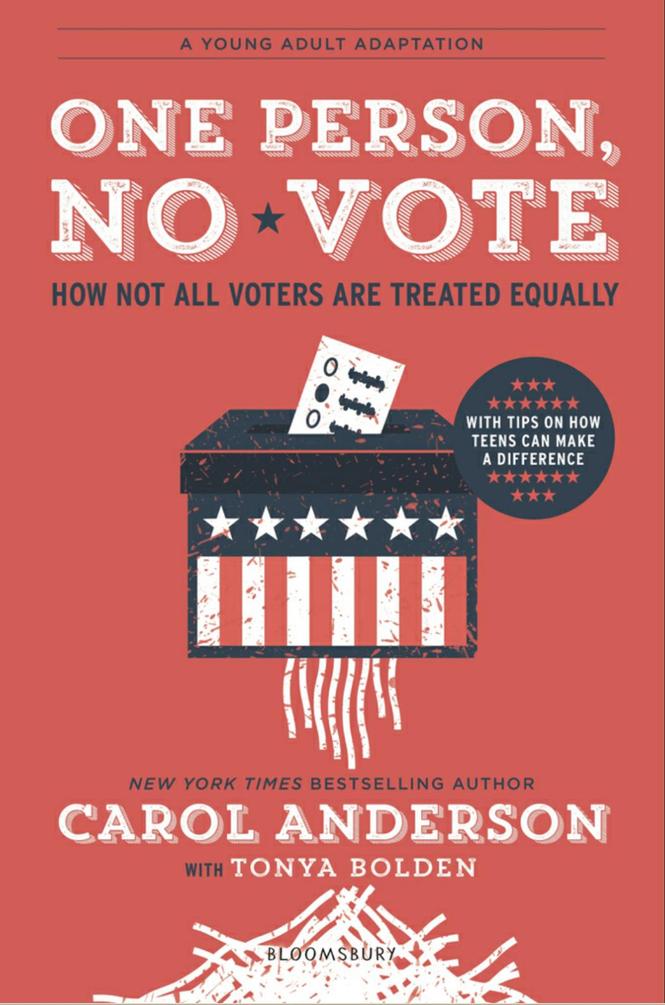
One Voice – One Vote
History of Voting Rights For African-Americans
Freed Slave Men Given the Right To Vote.
After Reconstruction, Voting Suppression Started.
  State and local laws: Poll Tax and Literacy Tests.
  Intimidation - Ku Klux Klan.
  Democratic Party Process.
U.S. Courts Intervene to Protect Voting Rights in 20th Century.
  Nixon v Condon
  Brown v Board of Education of Topeka
Notes:
Presenter’s share something they learned from the book or from research for the presentation.
Dr. Carol Anderson’s book, One Person, No Vote highlights the shocking history on inequality for Voters’ rights in American History.
Prior to the 15th Amendment, only white men over age 21 that owned land were allowed to vote.
In the 14th Amendment, the U.S. Constitution grants rights to all men born or naturalized in the United States.
In the 15th Amendment, U.S. Constitution tried to eliminate racial barriers to voting, but many states still practiced voter discrimination.
Dr. Carol Anderson explains in great detail the various types of voter suppression tactics used over the history of injustice in America.
Examples of voter suppression tactics are Poll Tax and Literacy Tests.
The 19th Amendment allowed women the right to vote nationwide.
In 1923, Indian Citizenship Act granted Native Americans the right to vote.
In 1964, the federal Civil Rights Act was passed to allow all men and women over 21 the right to vote.
In 1965, the Voting Rights Act suspends the use of literacy tests.
The 26th Amendment in 1971 changed the minimum voting age from 21 to 18.
In 1975, the Voting Rights Act is renewed permanently banning literacy tests and requiring translated materials in areas with large populations with limited English skills.
In 1984, the federal Voting Accessibility for the Elderly and Handicapped Act requires polling places to be accessible to people with disabilities.
Although in the 20th century U.S. Congress started trying to protect voting rights, now in the 21st century, we still have inequality and injustice for American voting rights. Barack Obama’s election as president started a cascade of events that revoked voting rights put in place from the Voting Rights Act of 1965.
Question:
Does anyone know the name of the ruling that allowed districts with a history of racial discrimination to change voting requirements without approval from the Department of Justice?
Answer: The Shelby ruling.
In the next few slides, we will discuss these suppression tactics and restoration attempts in greater detail.

Slide 9

Poll Tax & Literacy Tests
How many bubbles are in a bar of soap?
Can you read and explain the constitution?
Can you explain the constitution if it was read to you?
Pay annual fee in order to vote
  Cumulative in some states
  Due months before election
  You could elect to have a white man pay the tax
Poll Tax finally outlawed in 24th Amendment
Notes:
Ask the students what is a Poll Tax is? Poll Tax is a fee charged to voters before they can vote. It was designed to stop poor and minority voters from voting.
Ask the students what is a Literacy test is? Literacy tests were designed to stop poor and minority voters from voting. Minority voters had to answer questions which White voters didn’t know the answers to.
Ask the students if they have heard of any other “tests” minority voters had to pass to vote. Some examples of voter suppression through poll and literacy tests include: asking voters to identify how many bubbles are in a bar of soap?; how many marbles are in a jar?; asking voters to read and explain the constitution.
Give the students background on how these particular voter suppression antics worked. For example, minority voter registration increased from 20K to 135K in Georgia just 1 year after abolition of poll tax.
Voter suppression was a new form of slavery - Some people used the payment of the poll tax as another way to keep minority people indebted to them after slavery.
Ask the students if they know when Poll Taxes were finally made illegal? Poll Tax was finally outlawed with the 24th Amendment to the Constitution stating, “The right of citizens of the United States to vote in any primary or other election for President or Vice President for electors for President or Vice President, or for Senator or Representative in Congress, shall not be denied or abridged by the United States or any State by reason of failure to pay any poll tax or other tax.” 24th Amendment to the Constitution was passed by Congress in 1962 and ratified by the states in 1964.

Slide 10
One Voice – One Vote
U.S. Congress Intervenes to Protect Voting Rights in 20th Century.
Civil Rights Act of 1957.
Voting Rights Act of 1965.
    Need pre-clearance from Justice Dept. before states changed voting rules.
U.S. Courts Reverse Course on Protecting Voting Rights in 21st Century.
  Shelby County v. Holder
    Gutted the Voting Rights Act
Notes:
U.S. Congress had to intervene to stop local and state governments from suppressing the minority vote. Congress enacted several laws protecting the right to vote.
Ask the students what the Civil Rights Act of 1957 protected? - President Dwight D. Eisenhower signed the 1957 Civil Rights Act into law which created the Civil Rights Division at the Department of Justice and gave federal prosecutors the right to go to court to enjoin cities and states from interfering with voting rights.
Ask the students what the Voting Rights Act of 1965 protected? - President Lyndon B. Johnson signed the 1965 Voting Rights Act which placed the burden on the city to prove its actions weren’t discriminatory; cities and states could not change the voting laws without preclearance from government
This law was needed in response to Mississippi diluting the votes of minority citizens by erasing district boundaries. This action later became to be known as gerrymandering.
Ask the students if minority voters have the protections today set forth in the Civil Right Act of 1957 and the Voting Rights Act of 1965? NO! BUT In 2013, the Supreme Court ruled in Shelby County, Alabama v. Holder that cities and states no longer had to get “preclearance” before changing local voting laws. This decision allowed local jurisdiction to close polling places in minority communities and enact other rules that made it harder to vote. The 2016 presidential election was the first national elections since the Voting Right Act was gutted and millions of voters were removed from the voting rolls.
Ask the students what forms of voter suppression exists today as a result of the gutting on the Voting Rights Act. See how many forms of suppression they know before you show them the next slide.

Slide 11
21st Century Voting Suppression
Voter Purges.
Poll Closures in Minority Neighborhoods.
Citizens United
Voter ID laws.
Gerrymandering.
Exact Match and Crosscheck.
Unwarranted Claims of Voter Fraud.
Disenfranchisement of Felons who Served their Time.
Notes:
Ask the students to define Gerrymandering - Gerrymandering is the act of carving up voting districts so that it gives one political party an advantage over the other.
Click the Gerrymandering link to see an example of Gerrymandering in Texas.
Ask the students what are Voter Purgers? - Voter purges are when states remove voters from the voter rolls because they didn’t vote in past elections or did not respond to mailings asking if their addresses have changed. This year, Texas Secretary of State tried to remove 90,000 people from the voter rolls alleging they were illegal. A federal judge stopped it. Instructor can get more information here: https://www.npr.org/2019/05/28/727528998/texas-voting-chief-who-led-botched-voter-purge-resigns.
Show students the graph of the effects of voter purges in the U.S. by clicking on the Voter Purges link.
Exact Match and Crosscheck - This system was created in Kansas and used to purge voters from the rolls if the voters’ names were similar, alleging duplicate people, or if the voter moved between elections, alleging duplicate registrations. The instructor can find more information about Crosscheck here: https://indivisible.org/resource/protecting-voting-rights-ending-crosscheck.
Show the students the graphic of example of errors made by Crosscheck by clicking the Exact Match and Crosscheck link.
Poll Closures in Minority Neighborhoods - Since Shelby v. Holder, city and state governments have closed polling places, where people go to vote, in minority neighborhoods at alarming rates to make it more difficult for minority voters, who often don’t have transportation, to vote.
Show students the graphic of the number of poll closures in the South by clicking on the Poll Closure in Minority Neighborhoods link.
Unwarranted Claims of Voter Fraud - Some public officials make allegations of people voting twice or voting illegally to build distrust in the election. The Brennan Center for Justice found there is between 0.0003 percent and 0.0025 percent of voter fraud. Instructor can get more information here: https://www.brennancenter.org/sites/default/files/analysis/Briefing_Memo_Debunking_Voter_Fraud_Myth.pdf
Show the students the statistics of the number of Voter Fraud Cases in Texas by clicking on the link.
Voter Fraud: Investigations only showed 31 cases of voter impersonation out of the 1 billion votes nationwide. This proves all claims of voter fraud were themselves fraudulent.
Disenfranchisement of Felons who Served their Time - Some state prohibit people with felony convictions from voting, even after they have served their time.In 2018, Florida voters approved a referendum to restore the rights of voters with felony records. Then the Governor issued a rule that all prior fines had to be paid before those with felony records could vote, which rule was upheld by the Supreme Court in 2020. In response, billionaire Michael Bloomberg paid the fines of 32,000 former felons so they could vote.
Show students the graphic by clicking on the Disenfranchisement of Felons link.
Citizens United - Citizens United v. Federal Election Commission is a Supreme Court decision which allowed corporations, political action committees, unions, etc to make political contributions. This decision has allowed unlimited funds into political campaigns which dilute the power and voice of the individual voter.
Show the students the chart on the effects of Citizens United by clicking on the Citizens United Link.
Voter ID Laws - Laws enacted to require voters to have a certain form of identification before they can vote.
Ask the students what types of ID are allowed to vote in Texas? Click on the Voter ID laws link to find the answer.
Ask the students which populations they think are affected by Voter ID laws? Young, elderly, poor and minority communities.
Although in Texas after 10/1/20 you can still use the ID without the star to vote, you cannot use it for any federal ID requirements. If this was an reason to hinder voting in TX how many people would be able to vote today?
In Marion County, a birth certificate is needed to get a Driver’s license or state id. However, the health department requires a driver’s license as proof of identification to get a copy of birth certificate.
Instructor can get more information about the impact of voter suppression in each state here: https://www.naacpldf.org/wp-content/uploads/Democracy-Diminished-Redraft-D-10-7-19.pdf
Voter ID laws - Poll Closures: Ohio allocated only 1 polling station per county for early voting. Goal is to block as many people from voting by any means necessary

Slide 12
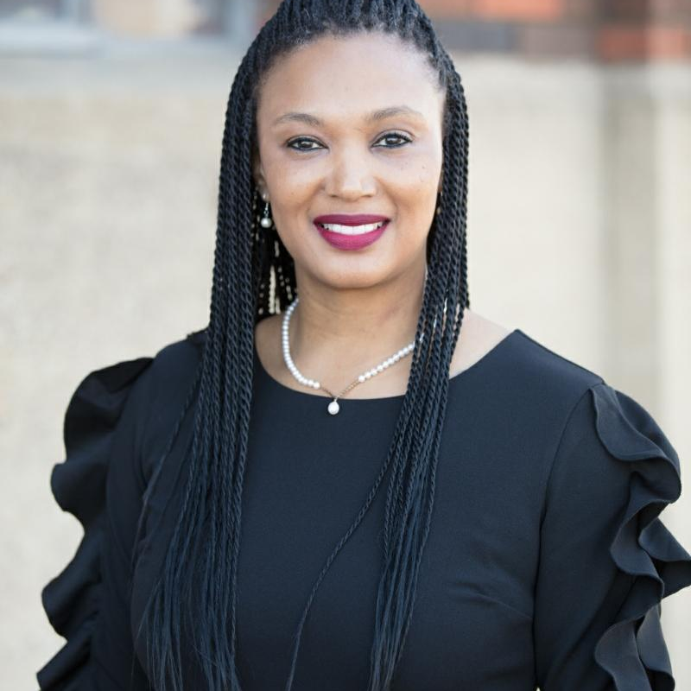
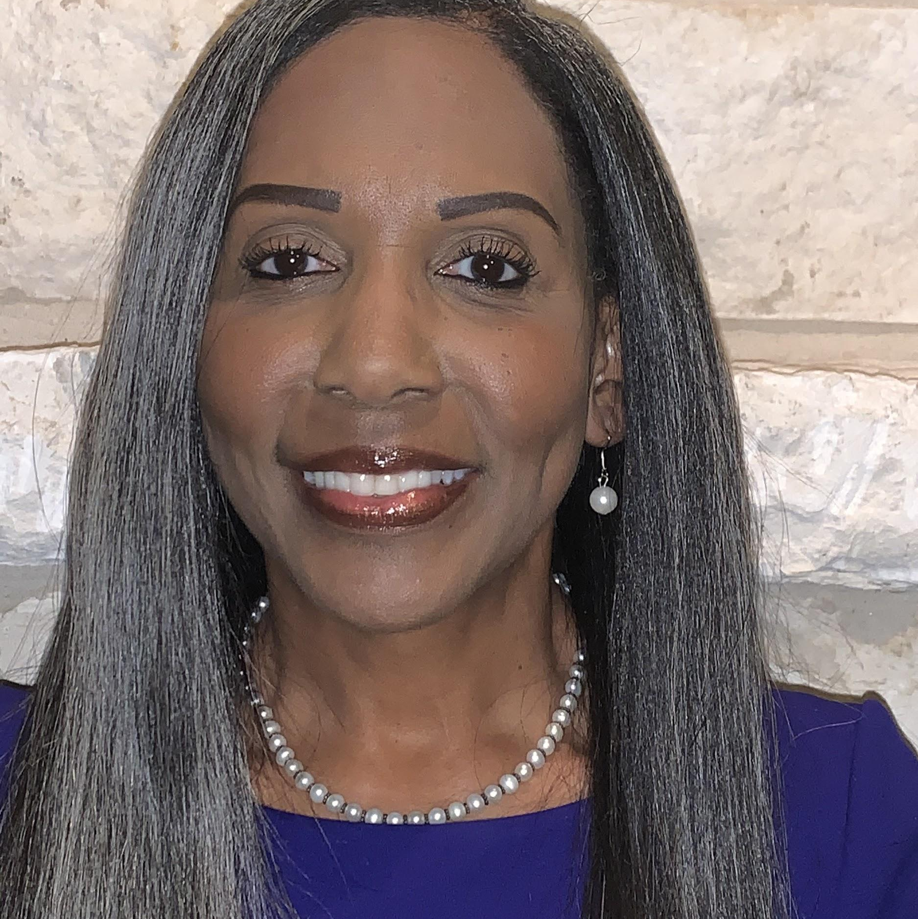
Election Results
Candidate Emerald Green
Candidate Rose White
Notes:
Provide results from earlier vote with explanation of suppression tactics used.
Show the results on screen share to everyone.
Questions for the students: Do you think the election was fair?

Slide 13
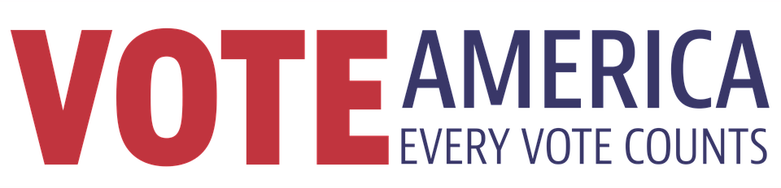
Time to Revote

Slide 14
Election Results
Candidate Emerald Green
Candidate Rose White
Notes:
Provide new results without any suppression tactics.
Show the results on screen share to everyone.

Slide 15
What’s on your mind?
Questions

Slide 16


